Slide 1
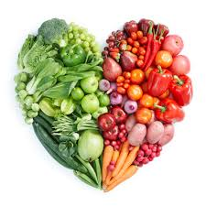
I Love Healthy Food
You Should, Too!
Presented by: _____________________
Notes:
Say: Hi I’m ________ and I am here to tell you about why healthy food is beneficial.
Read title: I Love Healthy Food.
Click 1: You Should, Too!

Slide 2
Claim: Healthy food is beneficial!
Reason 1: Eating healthy food leads to a happier life.
Reason 2: Eating healthy food helps you think and learn better.
Notes:
Say: Did you know that eating healthy food such as fruits and vegetables is good for you?
Click 1: Well, one benefit of eating healthy food is that it leads to a happier life. When you are healthy you are happier.
Click 2:Another benefit of eating healthy food is that it helps you think and learn better.

Slide 3
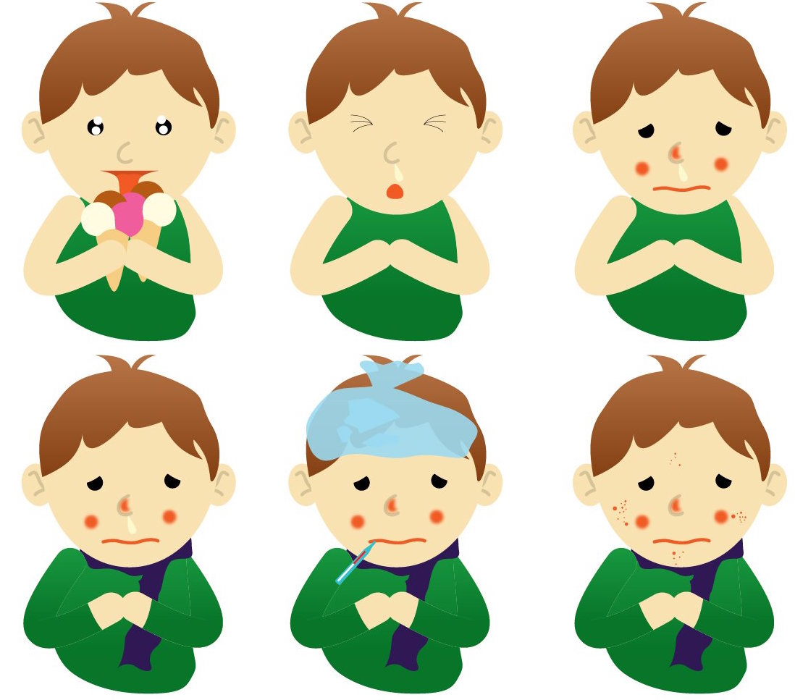
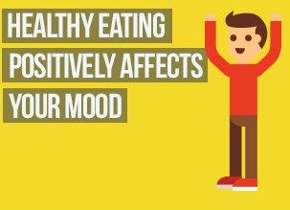
Reason 1: Eating healthy food helps you to be happy.
When your body is not healthy you get sick a lot, which is not fun.
When your body is healthy you don’t get sick and you have more time to have fun.
Notes:
Say: Like I said, one reason to eat healthy food is that it leads to a happier life.
Click 1: For example, when you eat junk food, it makes your body unhealthy. When your body is not healthy, you get sick a lot, which is not fun.
Click 2: Additionally, when your body is healthy you don’t get sick and you have more energy and time to have fun.

Slide 4
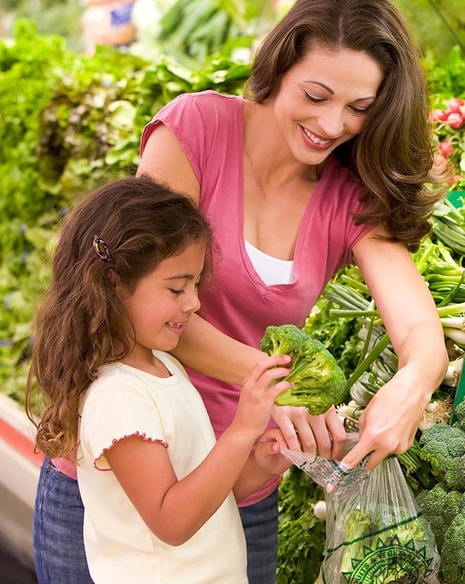
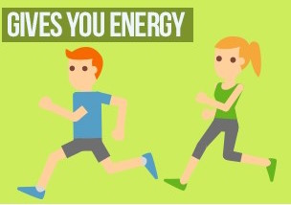
Reason 2: Eating healthy food helps you think and learn better.
Healthy foods have more vitamins and nutrition for your body.
The nutrients from healthy food give you energy to think and be active.
Notes:
Say: Another reason to eat healthy food is that it helps you think and learn better at school.
Click 1: For example, healthy foods such as fruits and vegetables provide more vitamins and nutrition for your body.
Click 2: Furthermore, the nutrients from healthy food give you energy to think, learn, and be active. Healthy food is good fuel for your body.

Slide 5
Informational Video About Healthy Food
https://www.youtube.com/watch?v=u1sh_XGKJ-Q
Notes:
Say: This is an informational video that provides additional information about the benefits of eating healthy foods.
NOTE: Show students the video by clicking on the image or the link. The clip is 5 minutes long. You may want to stop the video midway to save time.

Slide 6
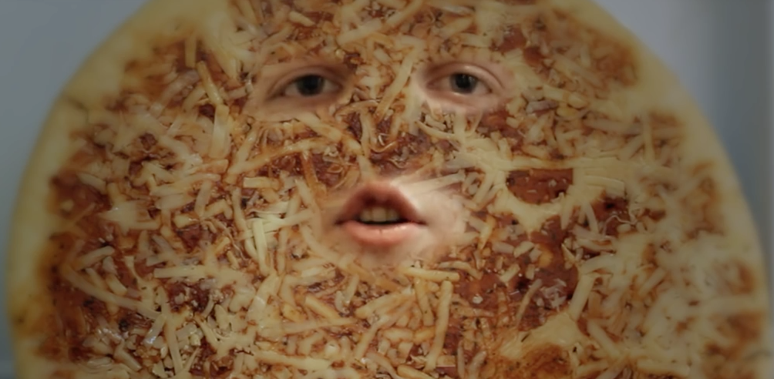
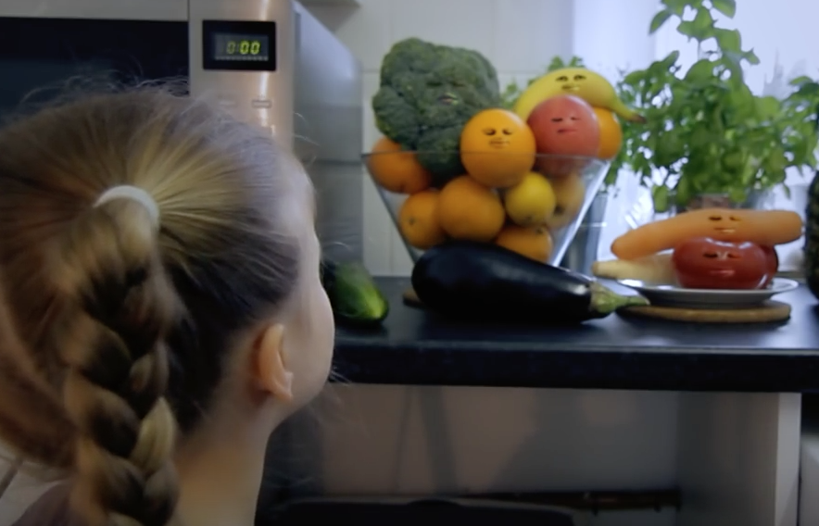
Key Ideas From the Video
Pizza and other unhealthy foods aren’t good for you. They can make you tired and don’t contain the nutrients your body needs.
It is much better to eat fruits and vegetables because they are full of vitamins and other nutrients that your body needs to stay healthy, strong, and active.
Notes:
Say: Here are some key ideas from the video that tell us why healthy food is beneficial.
Click 1: Pizza and other unhealthy foods aren’t good for you. They can make you tired and don’t contain the nutrients your body needs.
Click 2: It is much better to eat fruits and vegetables because they are full of vitamins and other nutrients that your body needs to stay healthy, strong, and active.

Slide 7
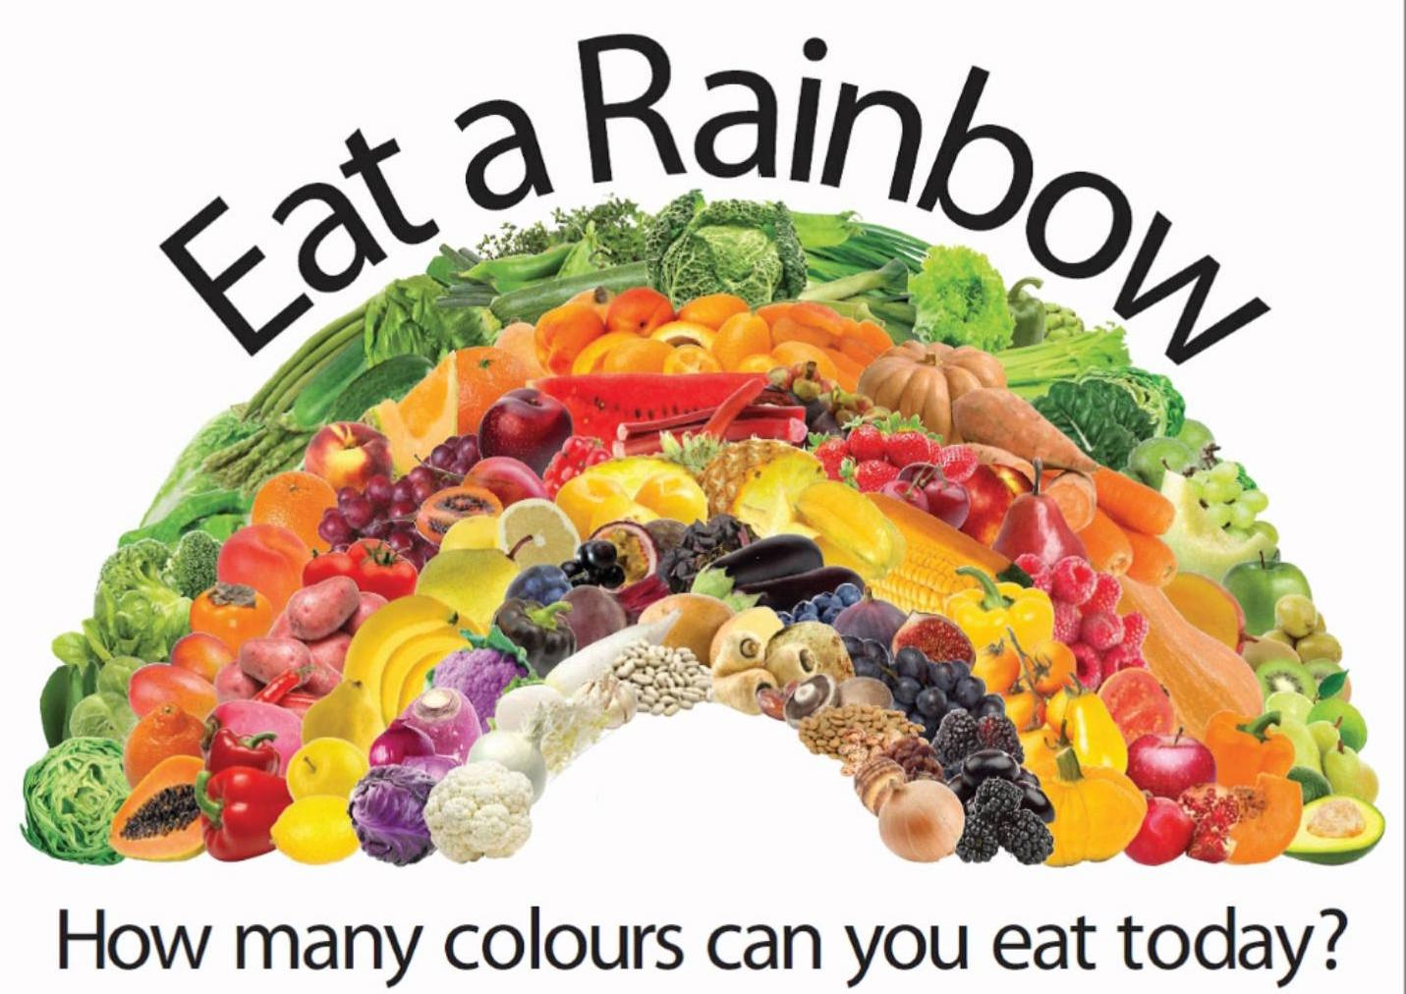
Conclusion
Healthy foods such as fruits and vegetables are beneficial because they help keep you happy, healthy, and strong. Start now! Eat a rainbow everyday!
Notes:
Say: I love healthy food, and you should too!
Click 1: Healthy foods such as fruits and vegetables are beneficial because they help keep you happy, healthy, and strong. Start now! Eat a rainbow everyday!

Slide 8
Questions?

